Slide 1
Security Overlay Of Enterprise (Part 2)
What are the traffic flows specific to good security design ?

Slide 2
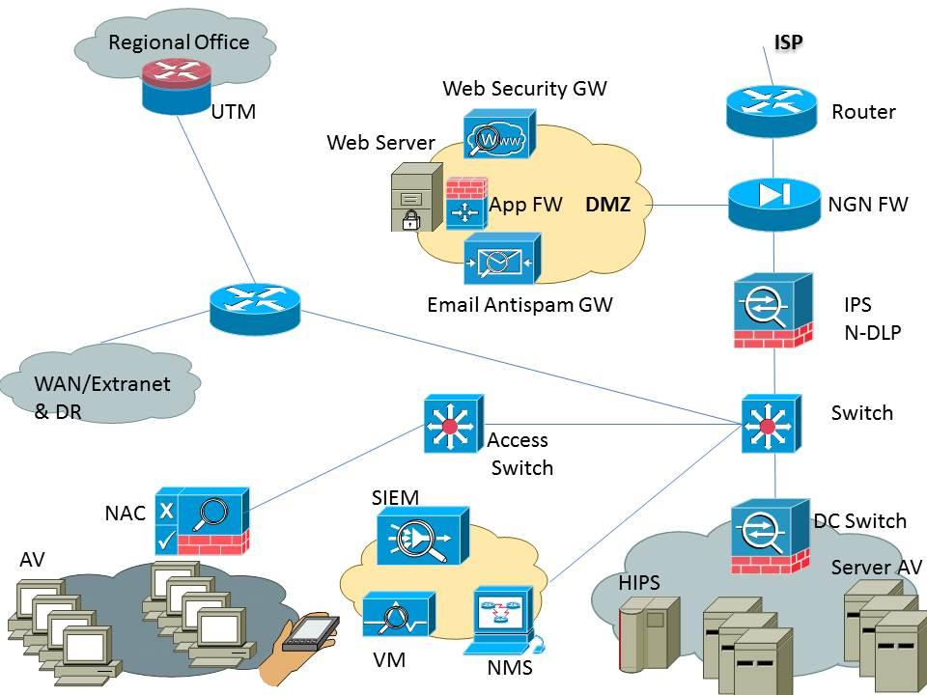
Security Overlay Of Enterprise (Part 2)

Slide 3
Security Overlay Of Enterprise (Part 2)

Slide 4
Security Overlay Of Enterprise (Part 2)

Slide 5
Security Overlay Of Enterprise (Part 2)

Slide 6
Security Overlay Of Enterprise (Part 2)

Slide 7
Security Overlay Of Enterprise (Part 2)

Slide 8
Security Overlay Of Enterprise (Part 2)

Slide 9
Security Overlay Of Enterprise (Part 2)

Slide 10
Security Overlay Of Enterprise (Part 2)

Slide 11
Security Overlay Of Enterprise (Part 2)
Granular access list filtering and a well planned and tested security design are keys to success

